Slide 1
10_Feeders_No_Foreign_WTIVs
t
e
x
t

Slide 2
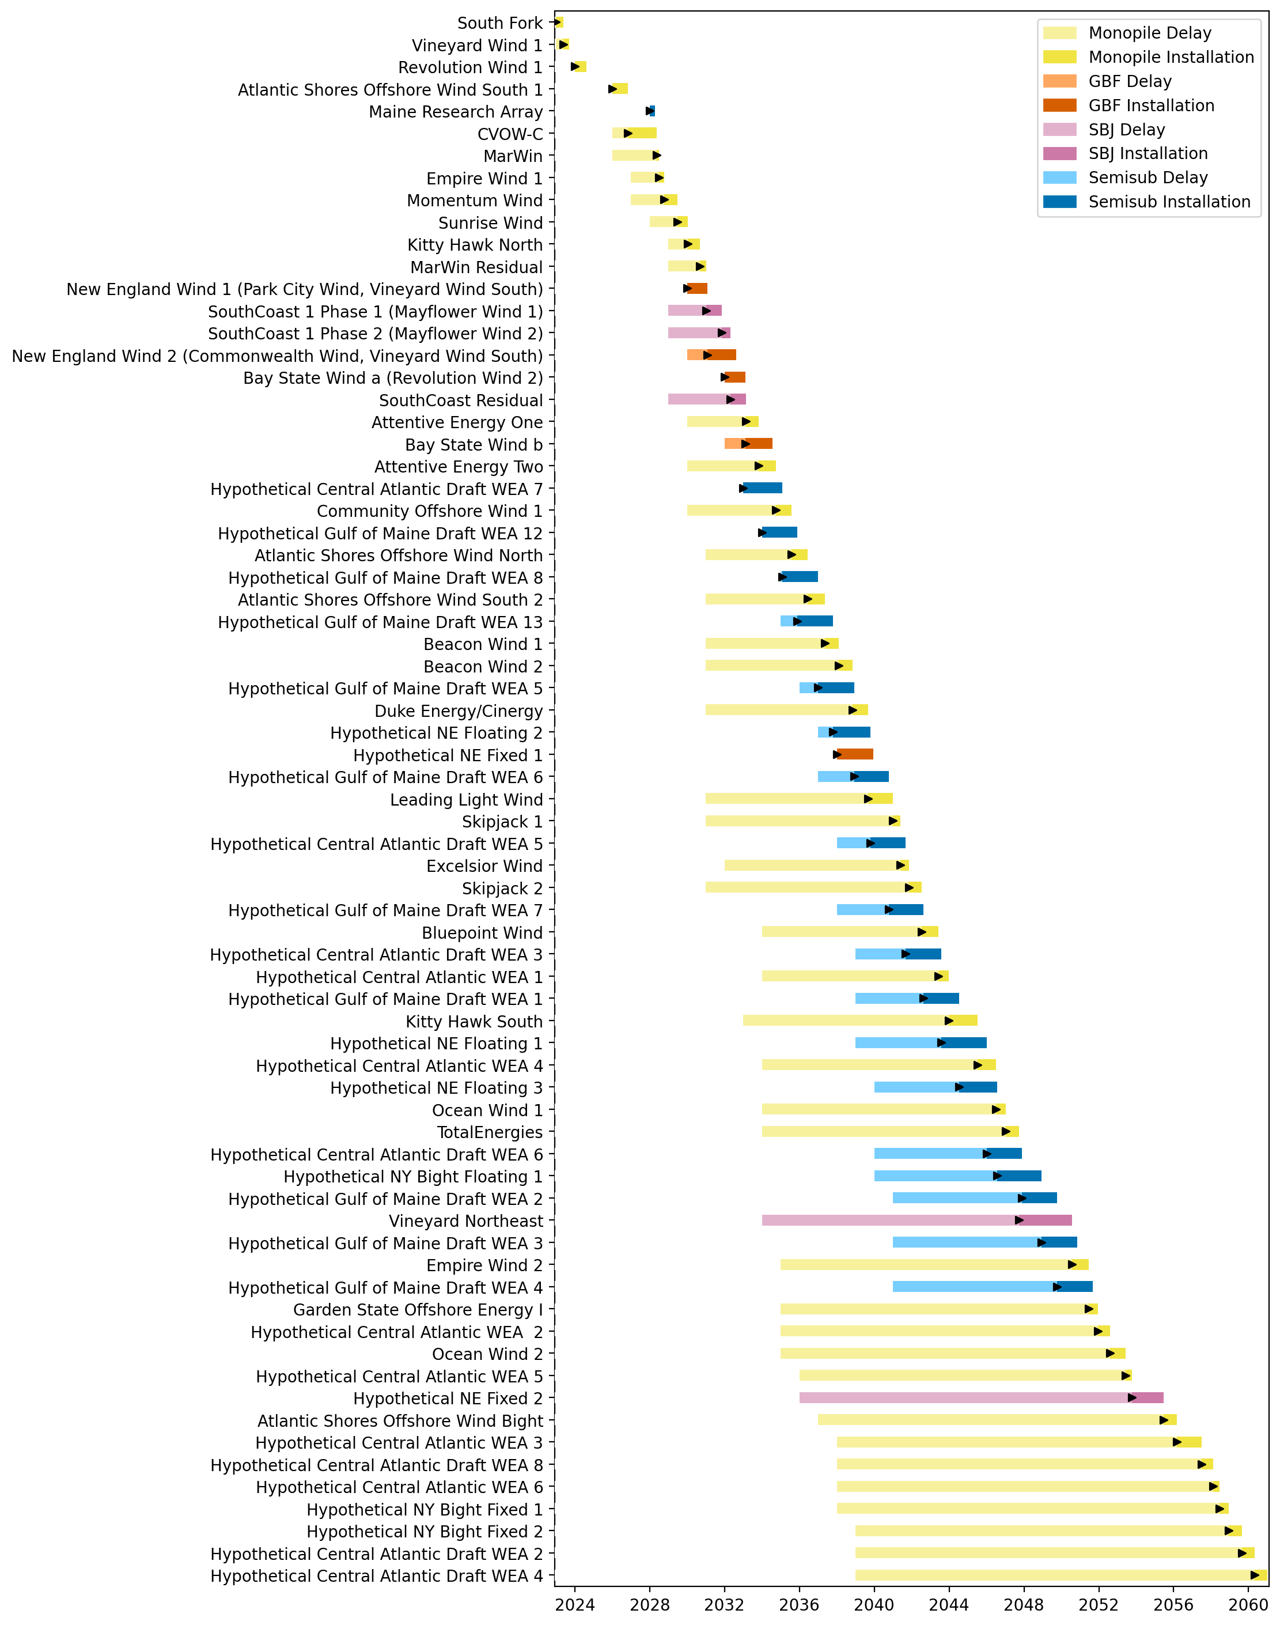
Full Gantt

Slide 3
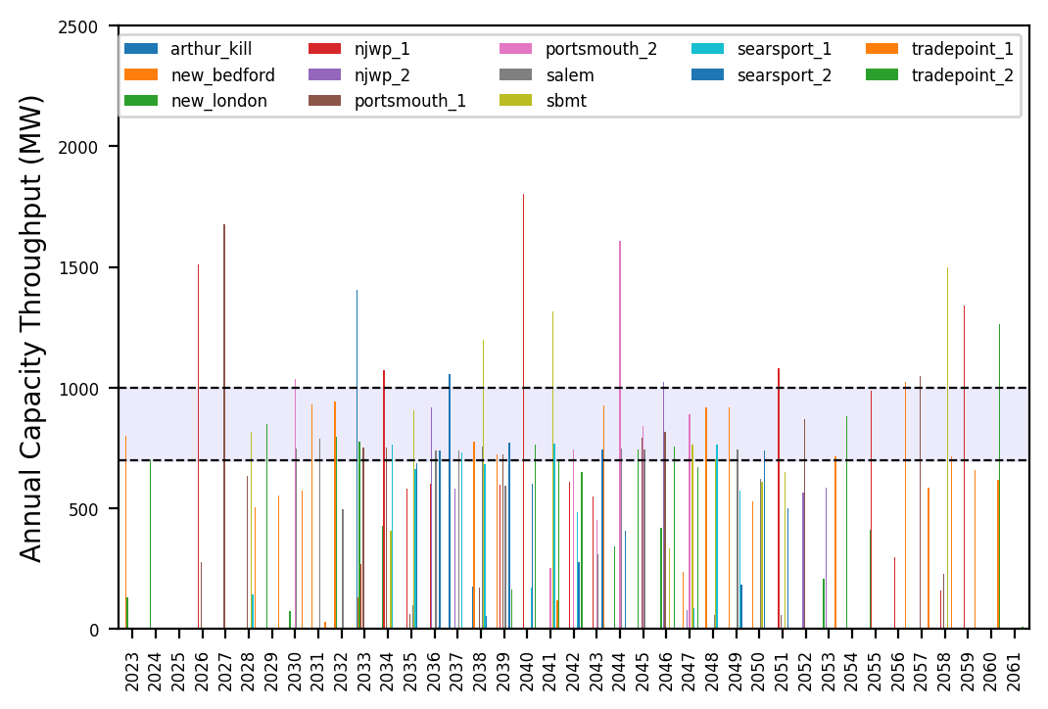
Port Throughput

Slide 4
Hybrid_Optimized_Pipeline_Low
t
e
x
t

Slide 5
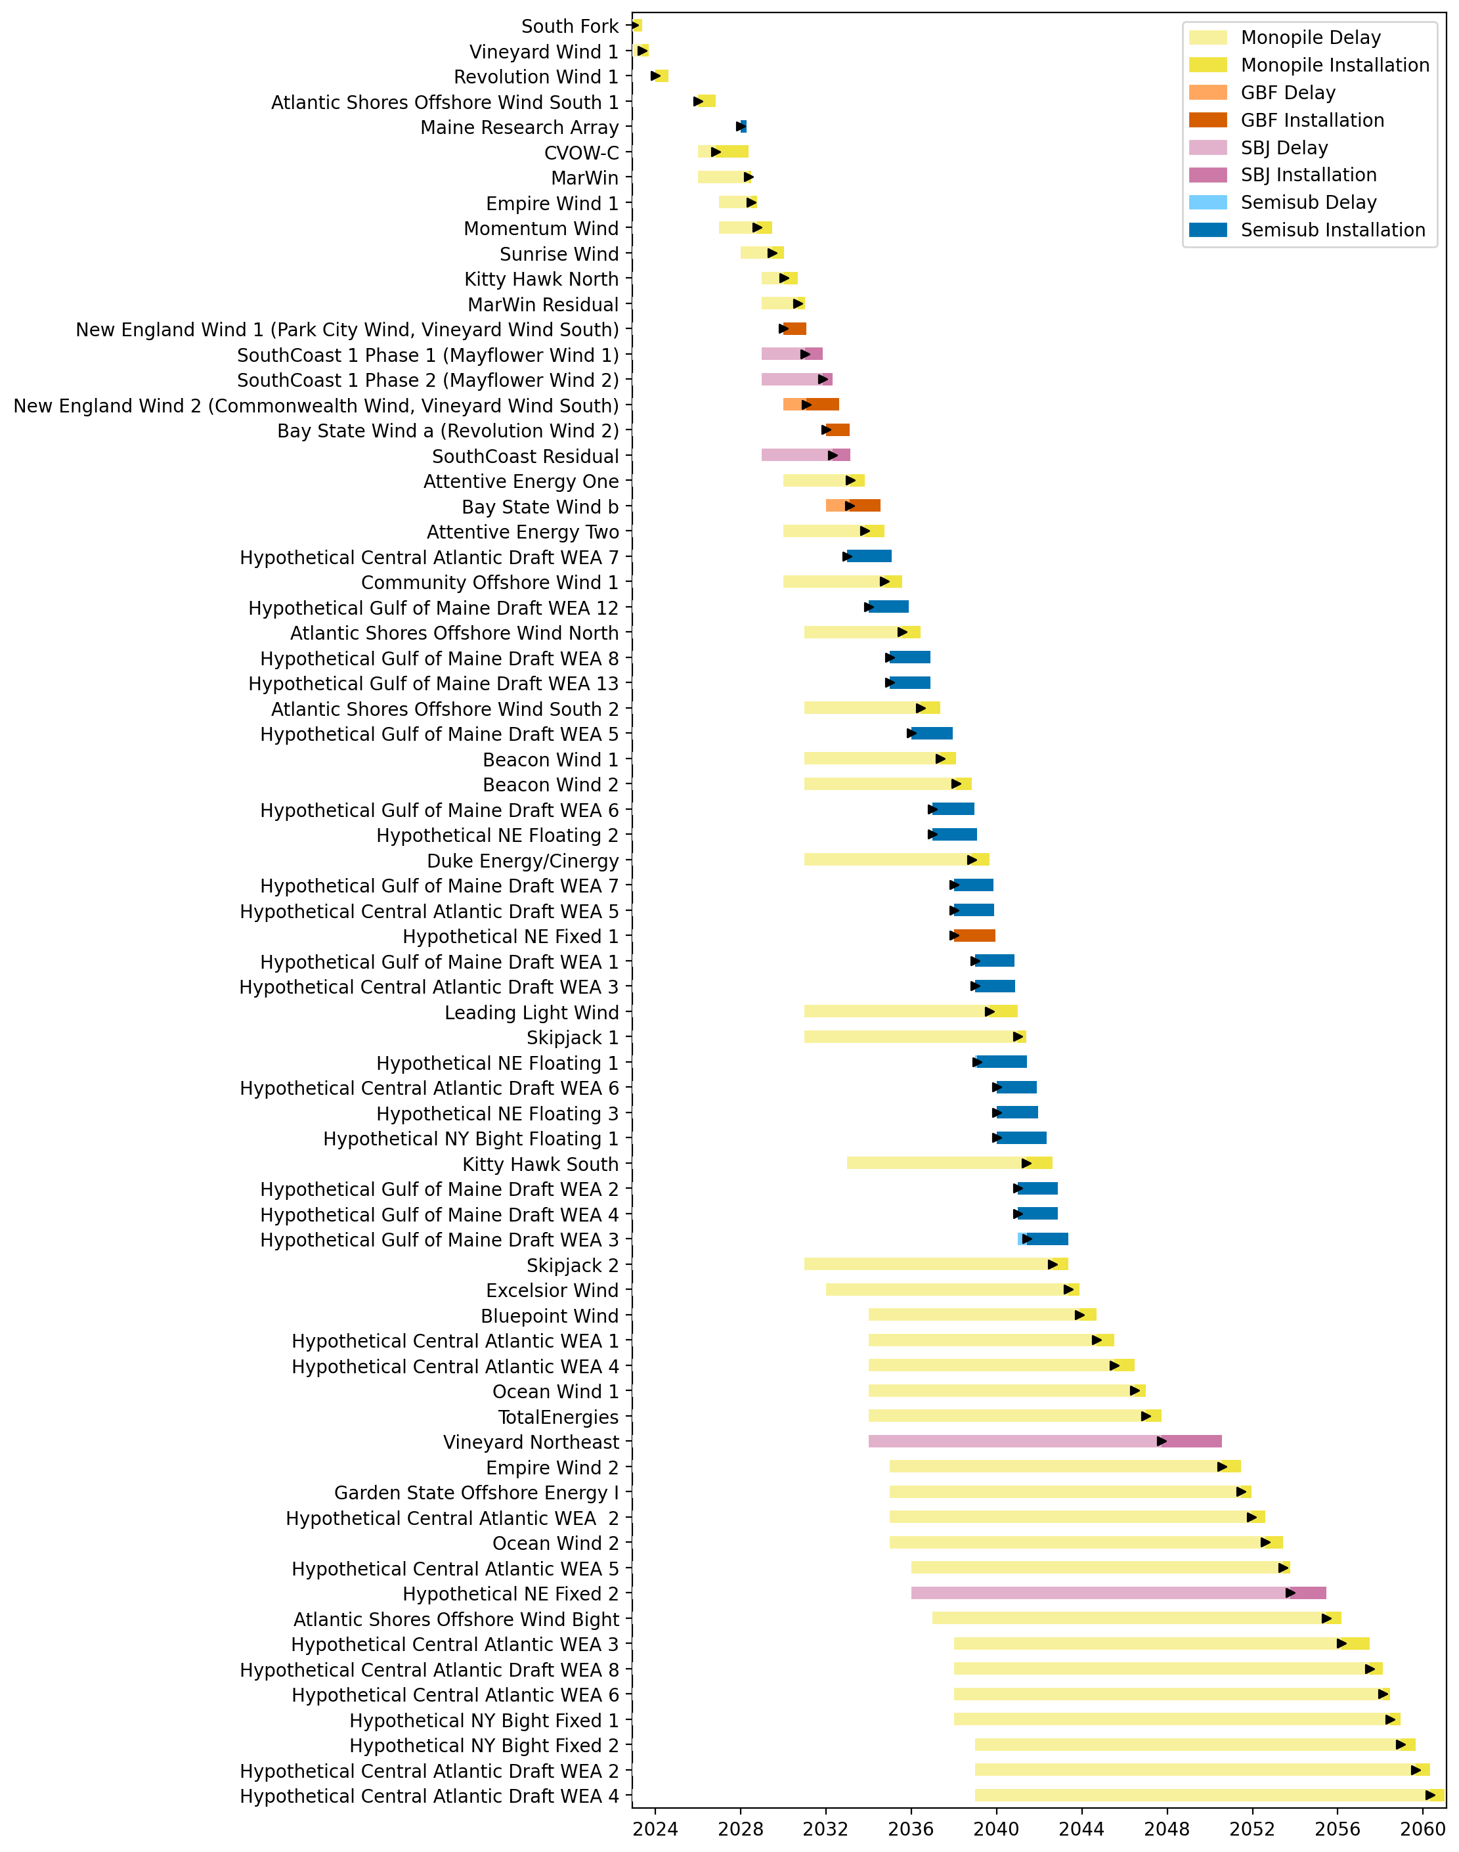
Full Gantt

Slide 6
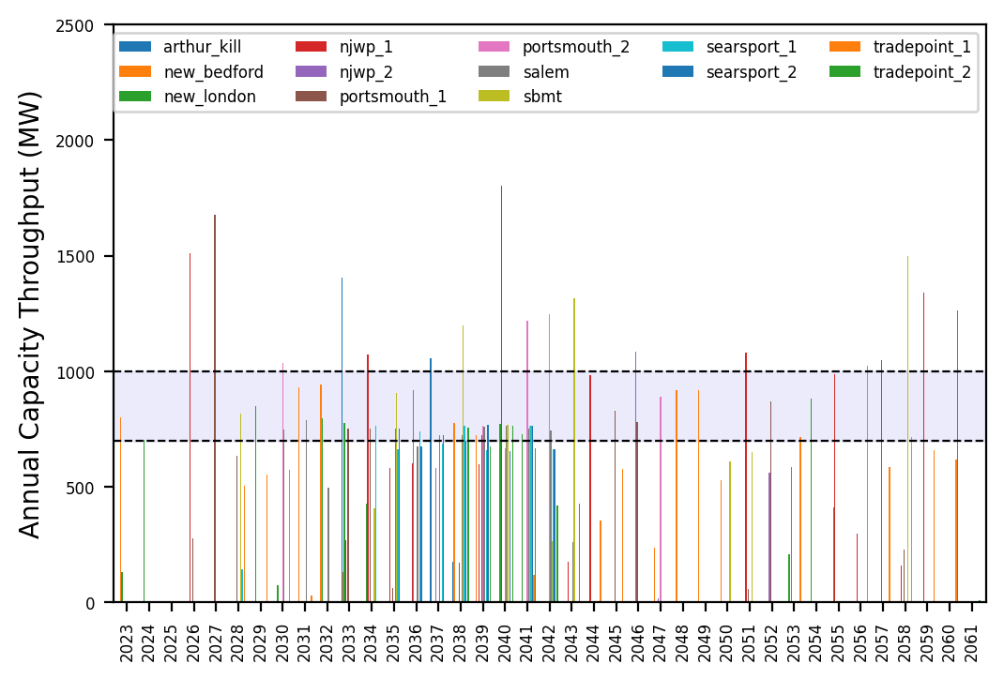
Port Throughput

Slide 7
10_Feeders
t
e
x
t

Slide 8
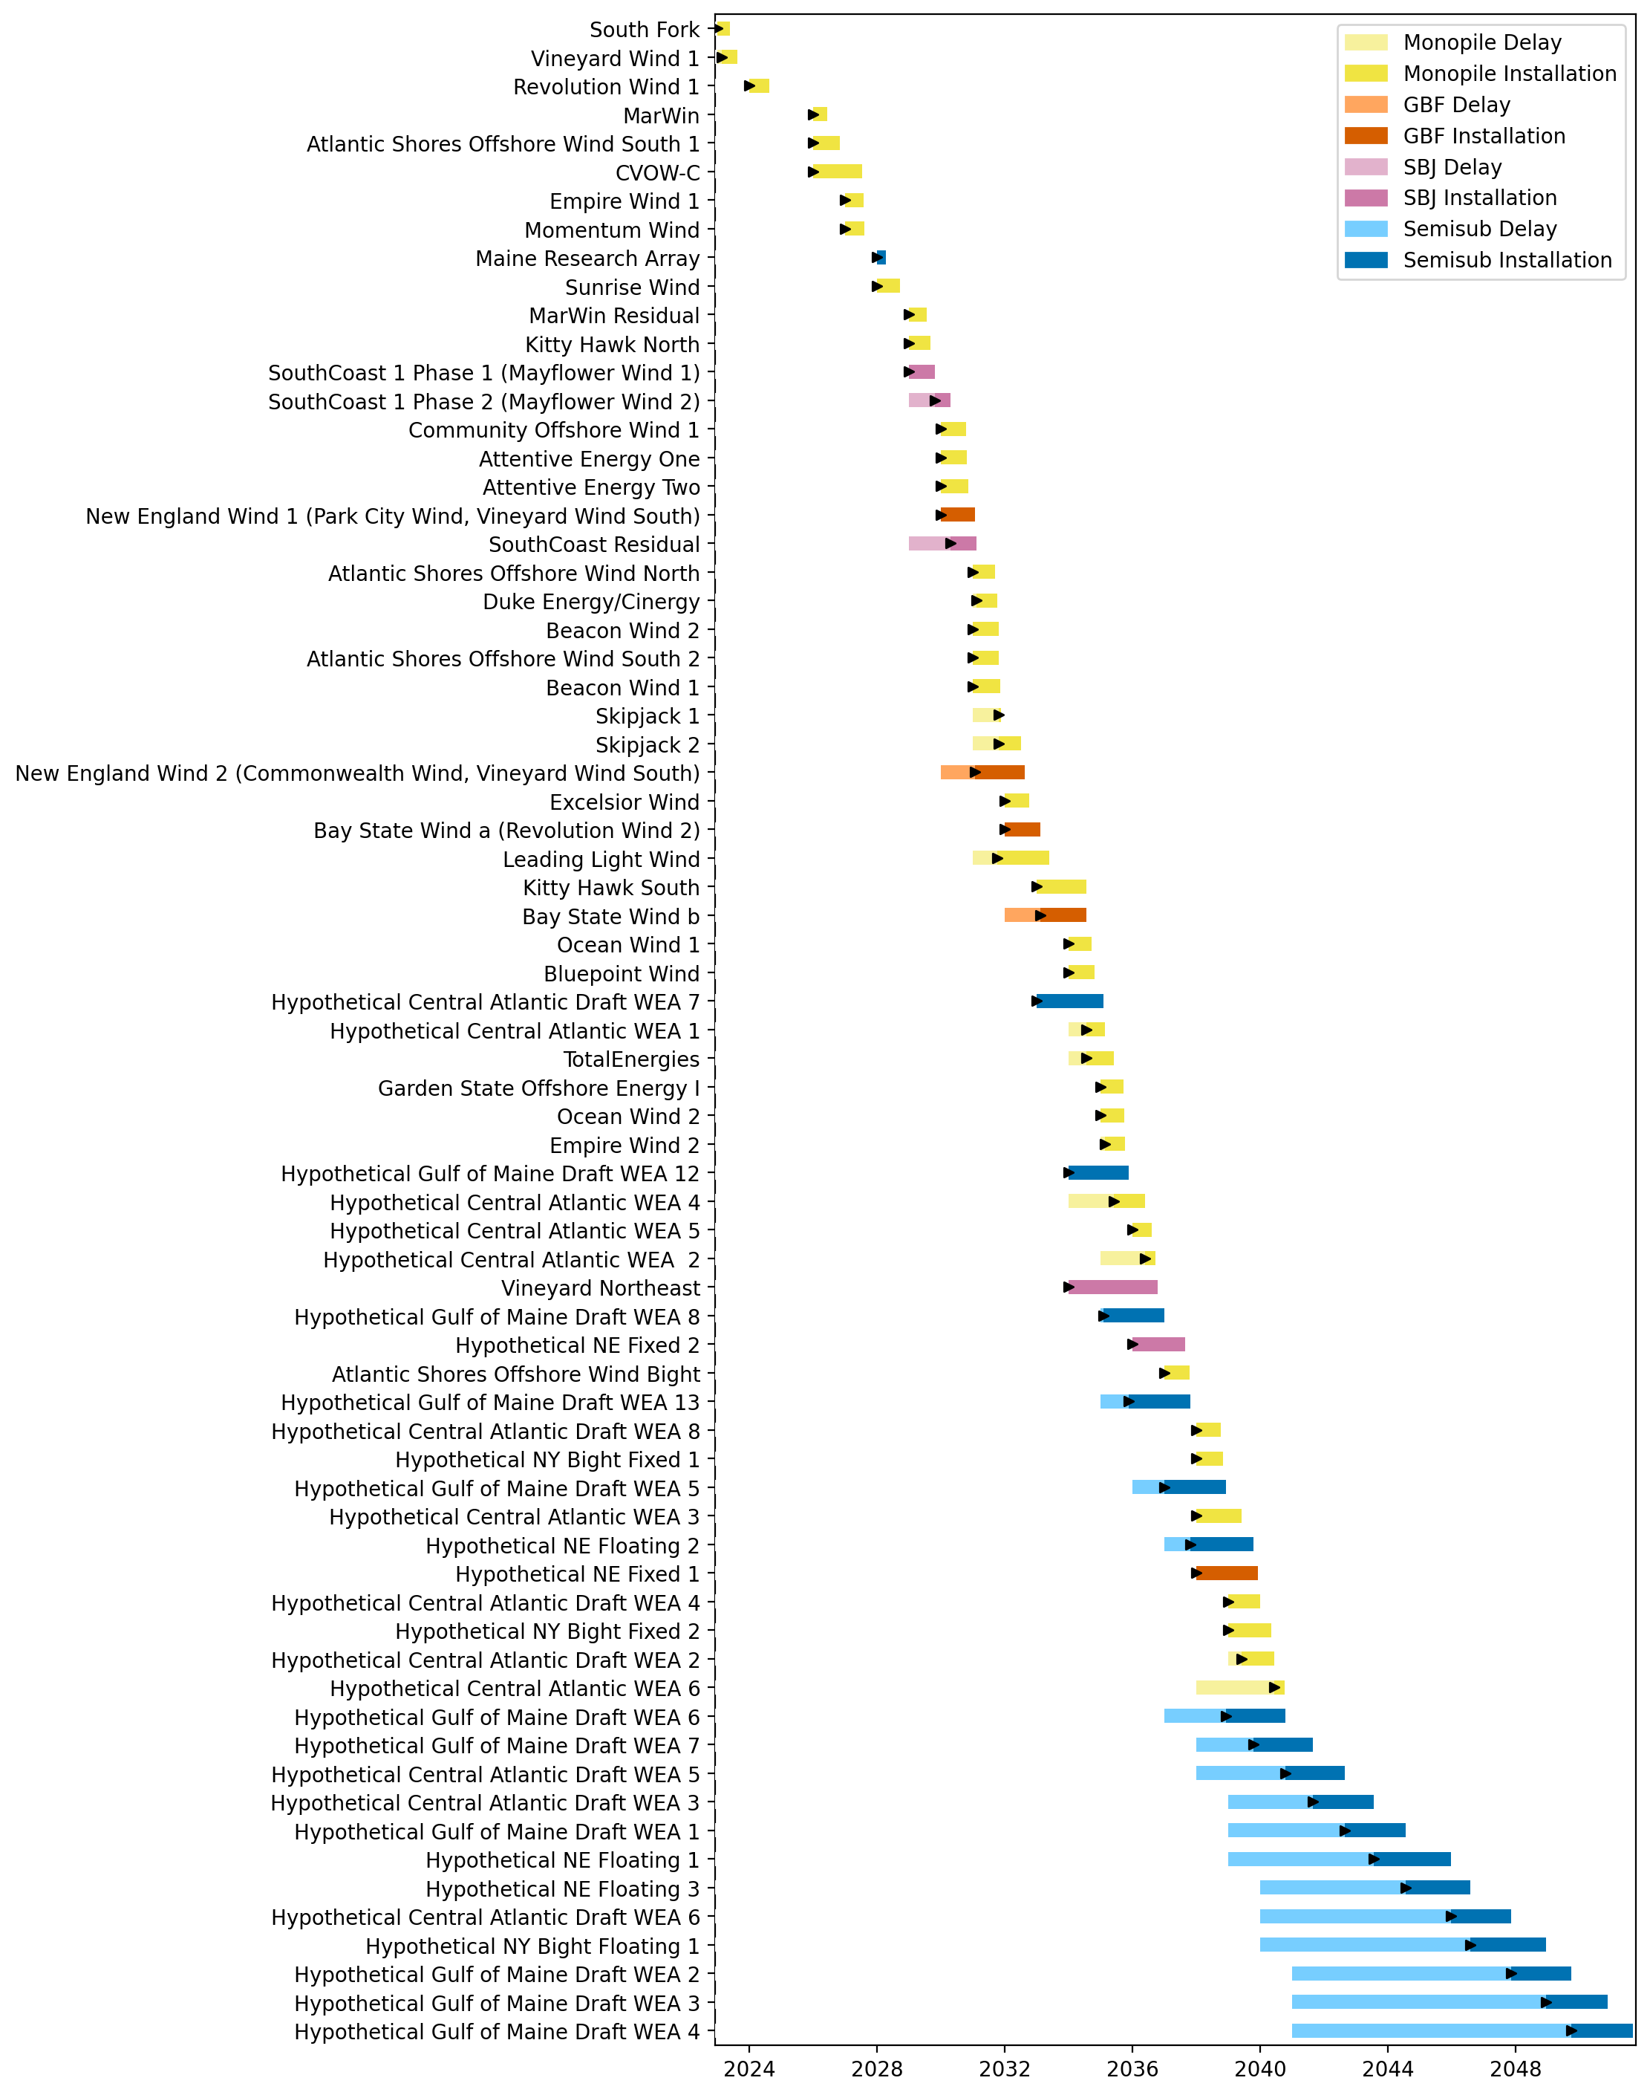
Full Gantt

Slide 9
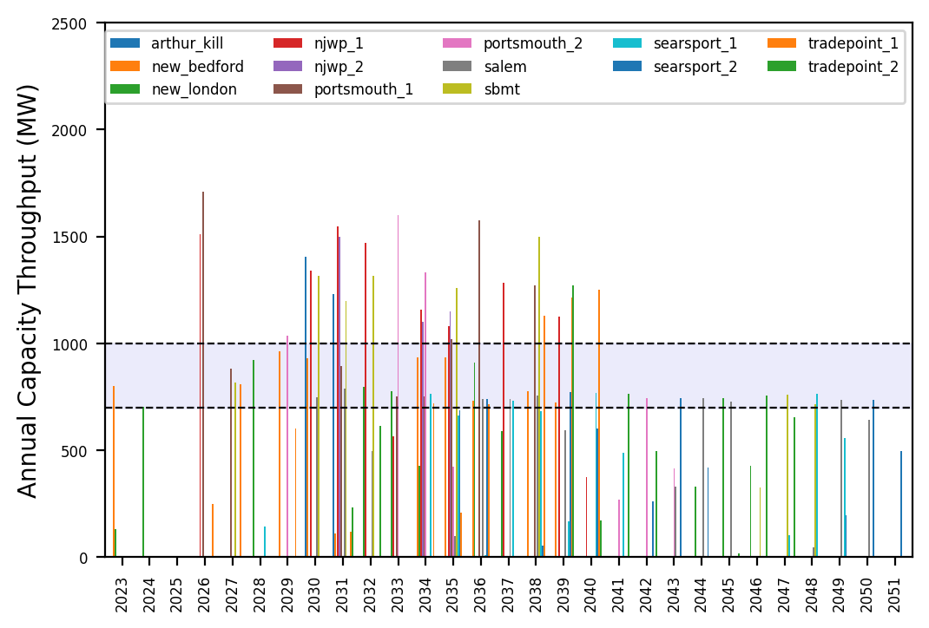
Port Throughput

Slide 10
3_WTIV
t
e
x
t

Slide 11
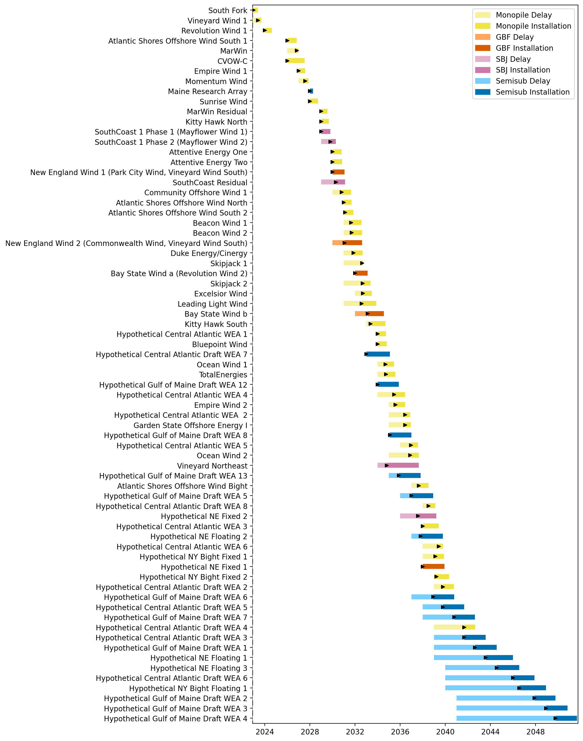
Full Gantt

Slide 12
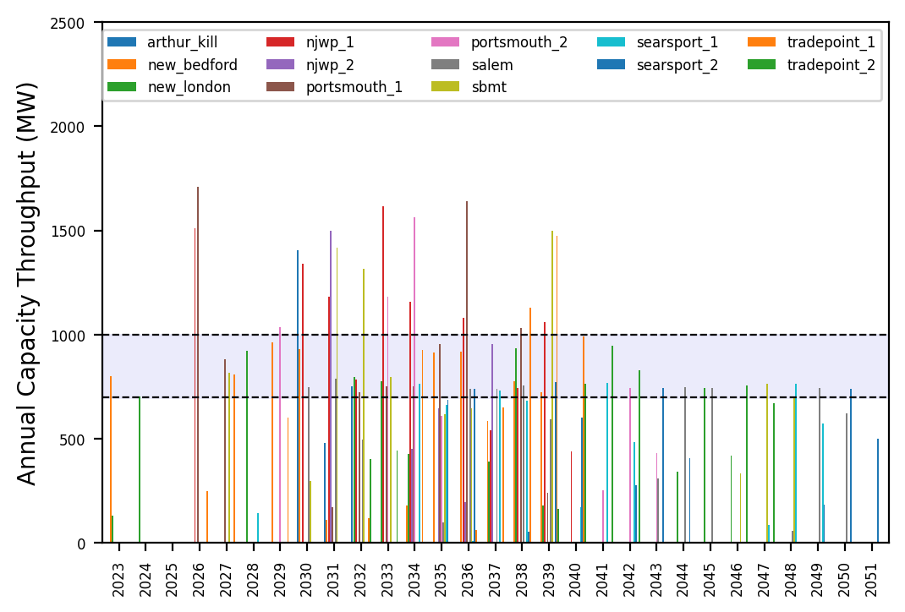
Port Throughput

Slide 13
6_AHTS
t
e
x
t

Slide 14
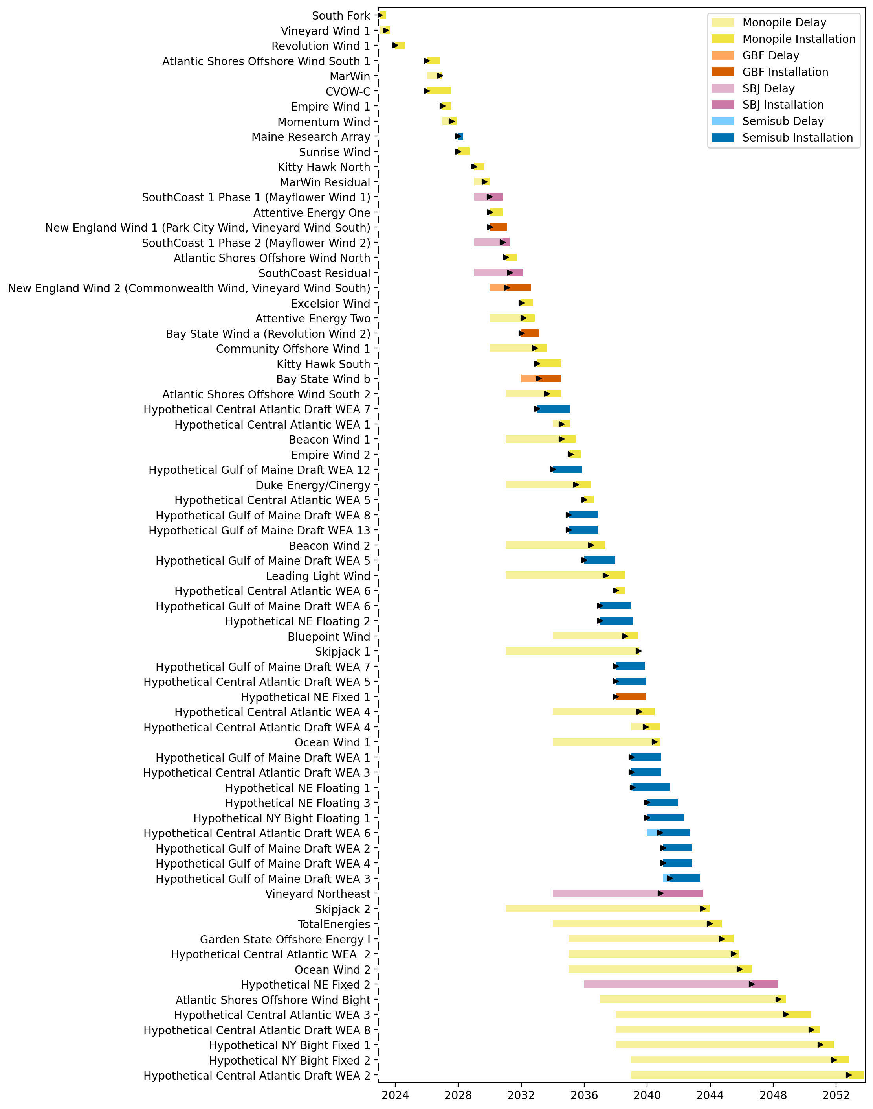
Full Gantt

Slide 15
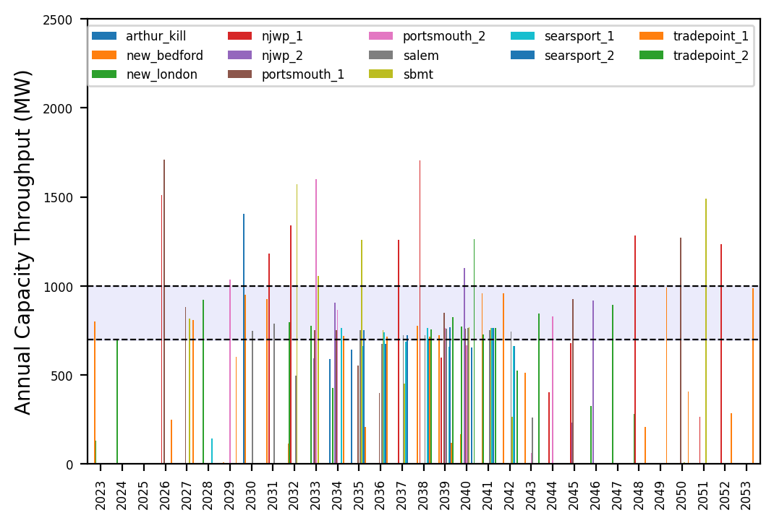
Port Throughput

Slide 16
no_action
t
e
x
t

Slide 17
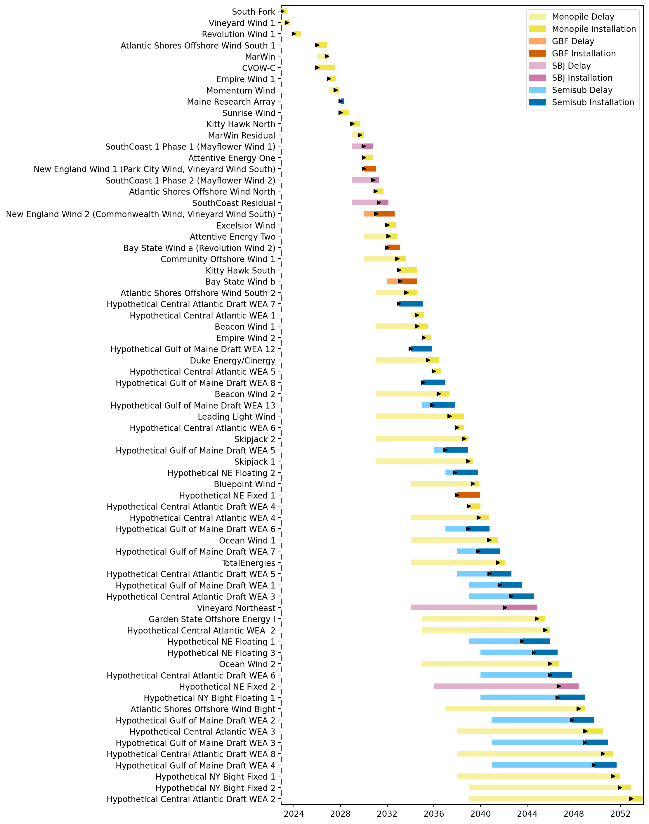
Full Gantt

Slide 18
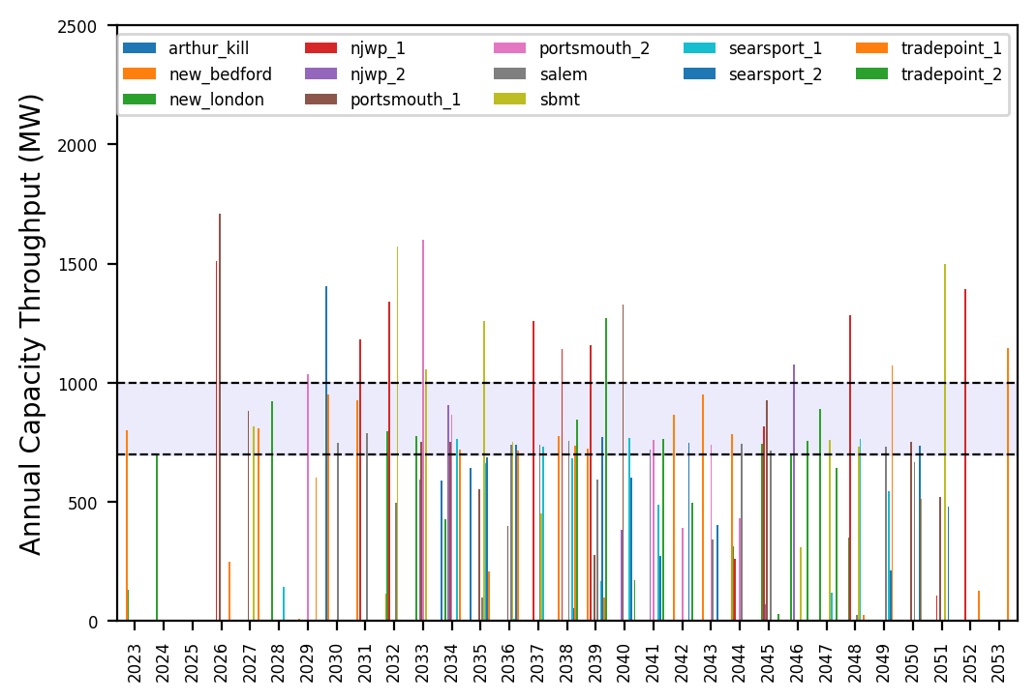
Port Throughput

Slide 19
Hybrid_Optimized_Pipeline
t
e
x
t

Slide 20
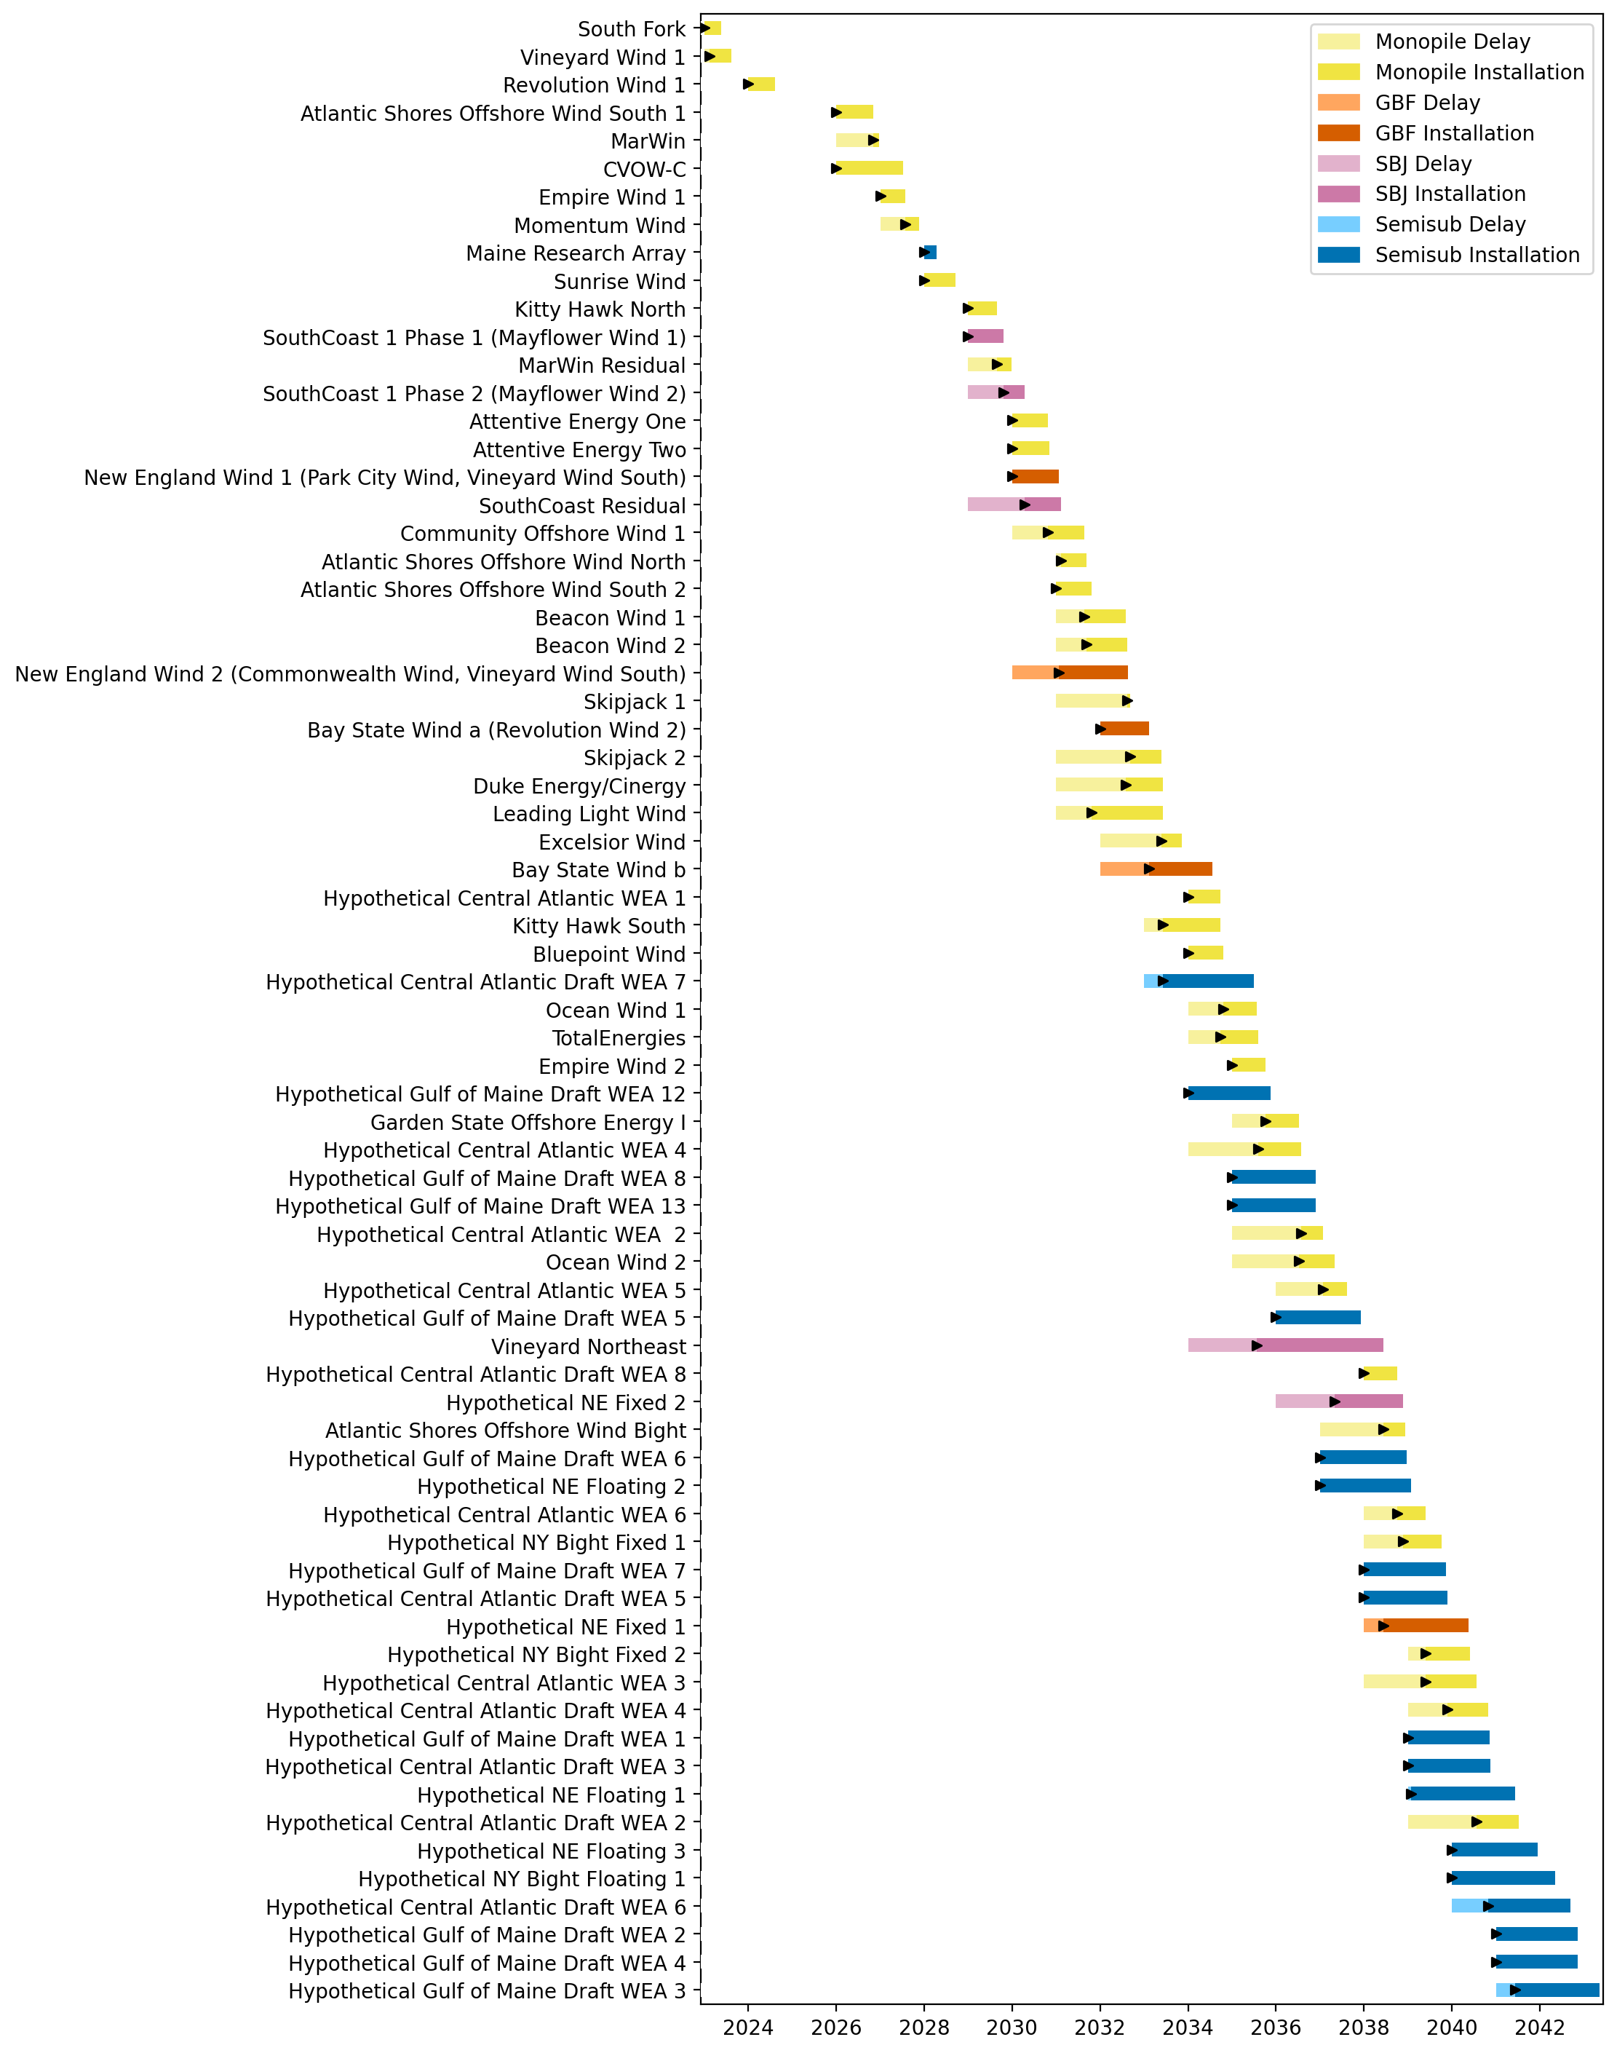
Full Gantt

Slide 21
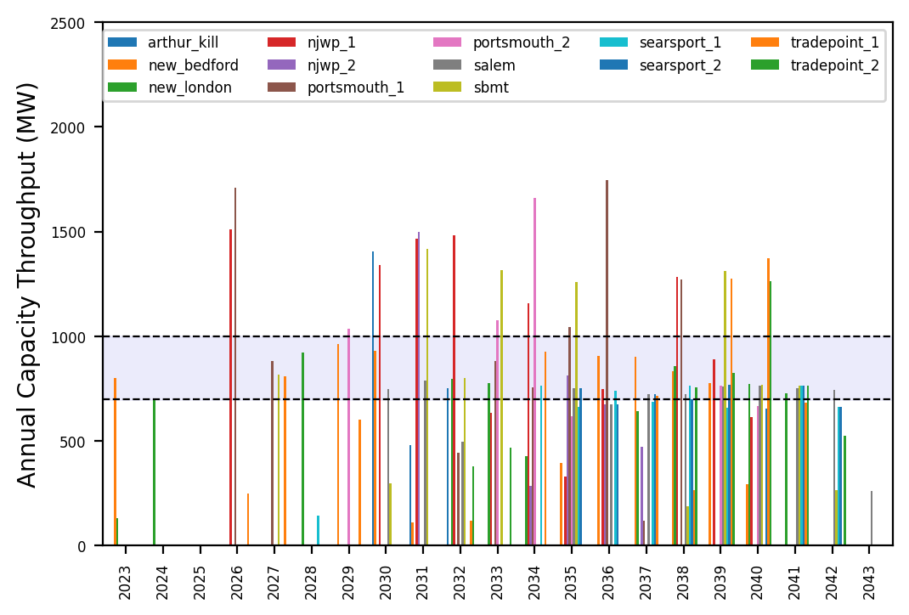
Port Throughput

Slide 22
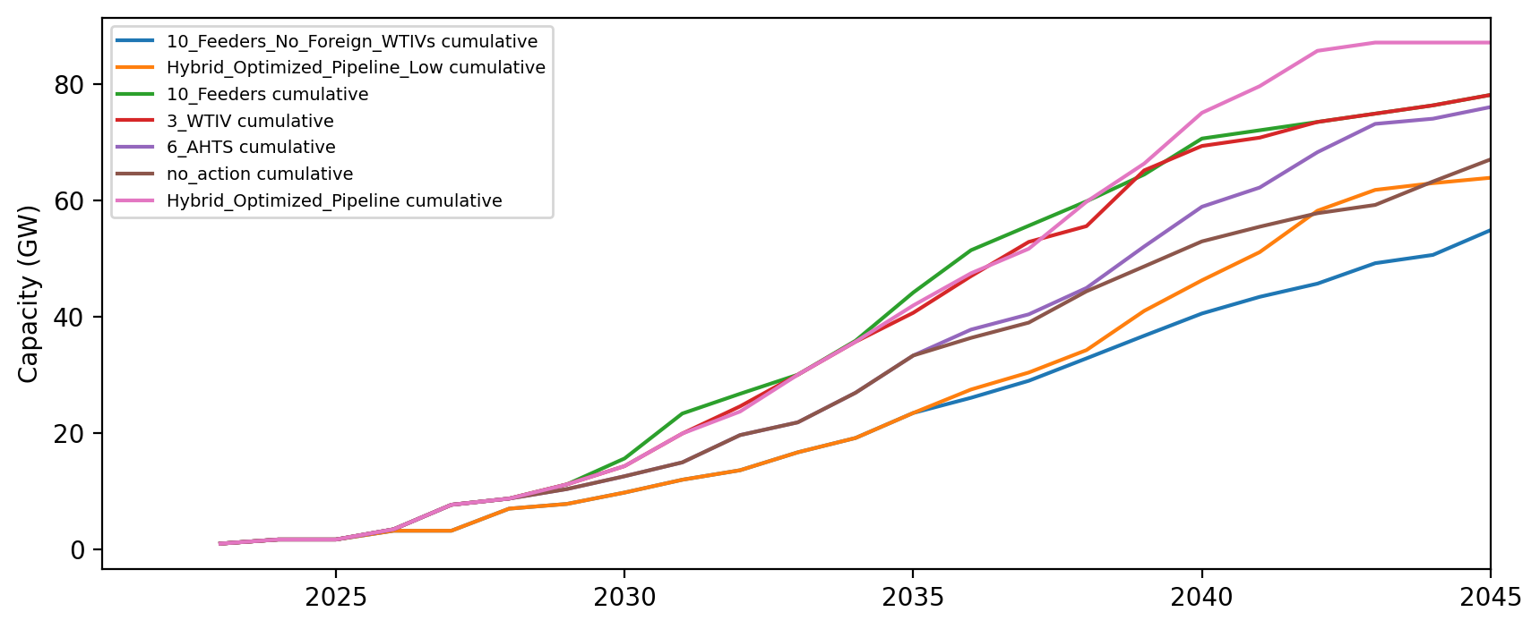
Installed Capacity

Slide 23
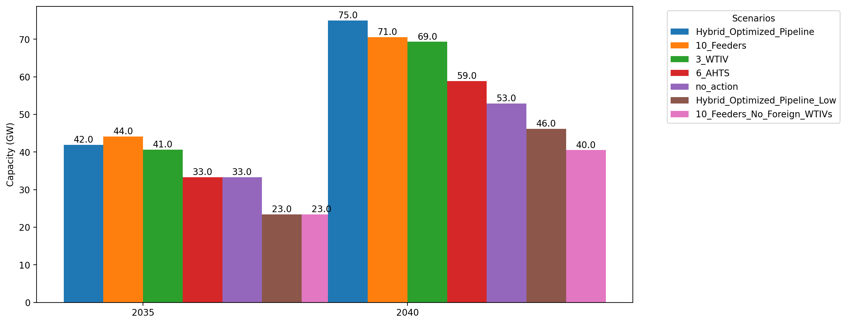
Cumulative Capacity by 2035 and 2040

Slide 24
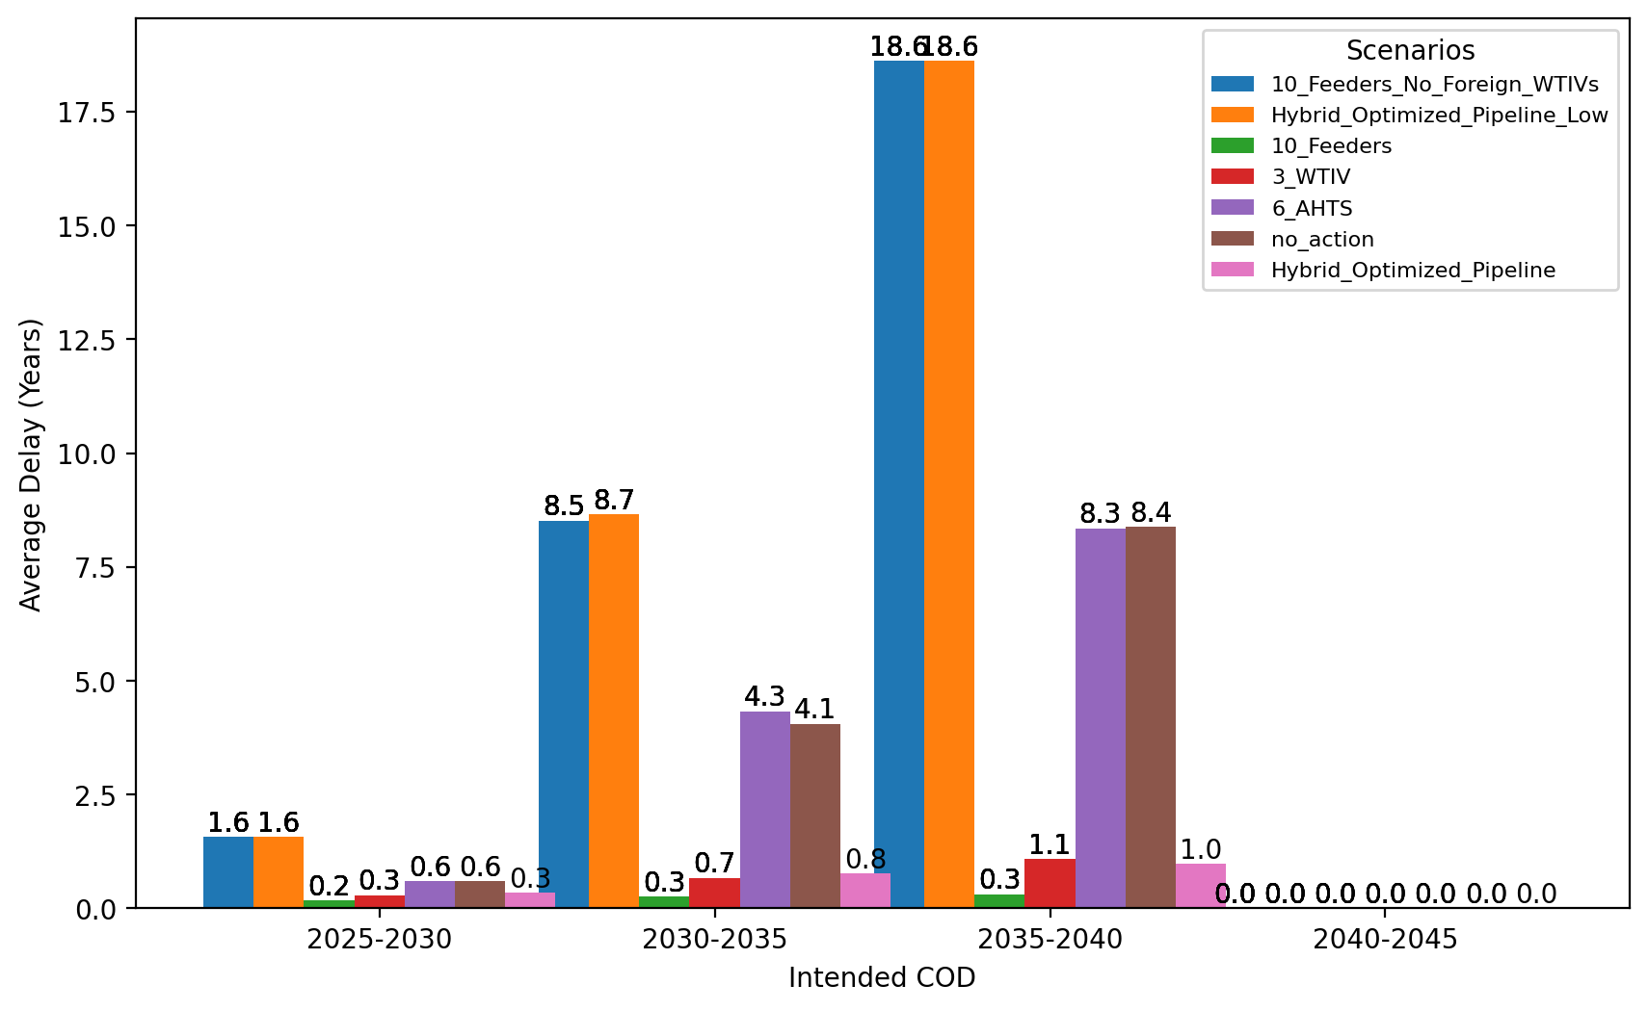
Average Delay Per Project by COD - All Regions

Slide 25
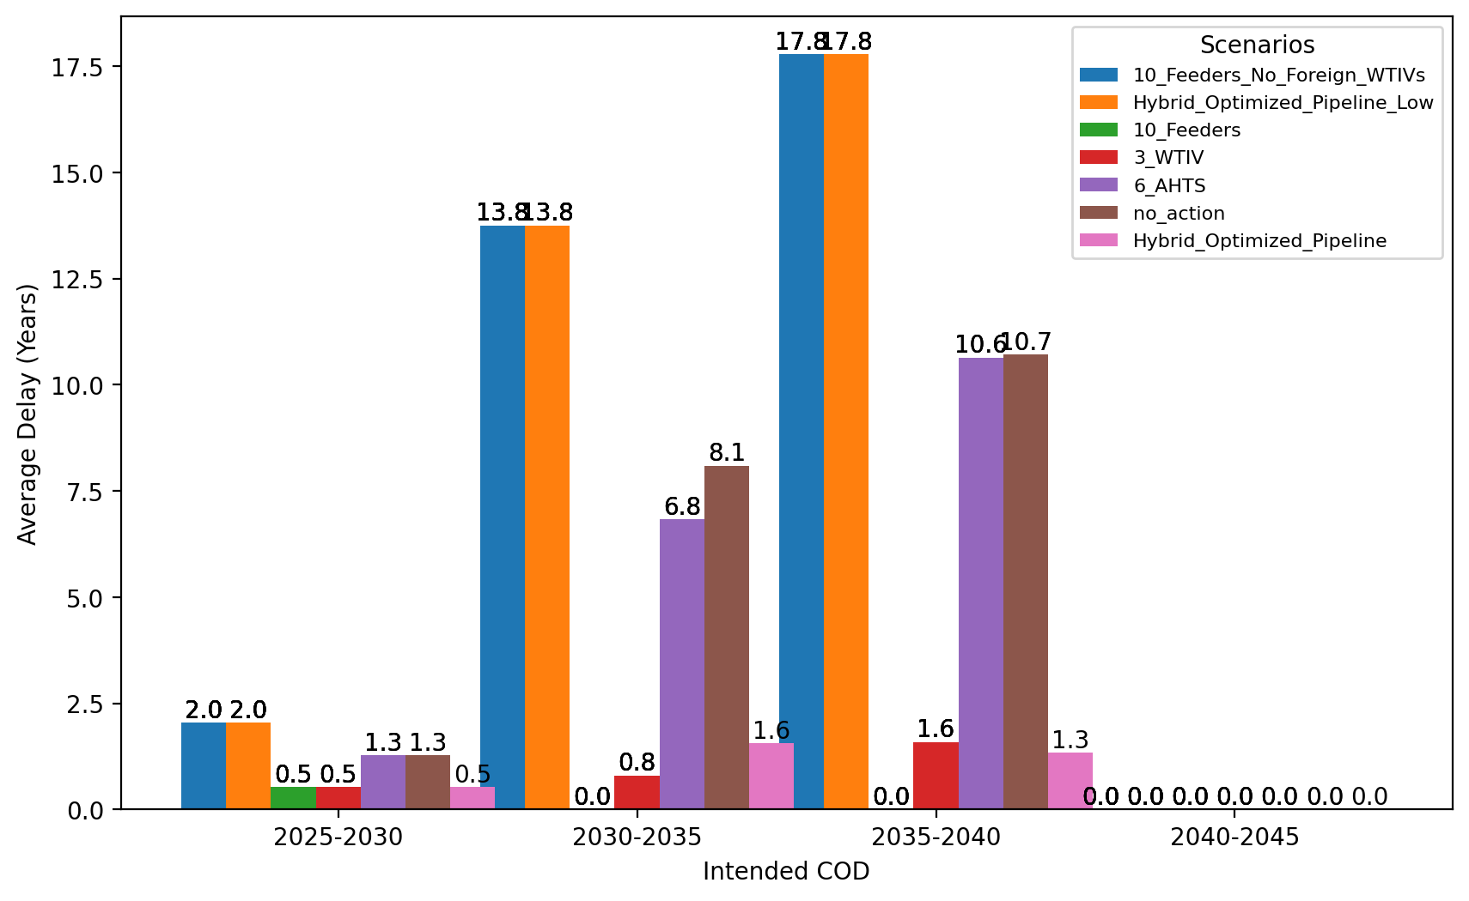
Average Delay Per Project by COD - NE

Slide 26
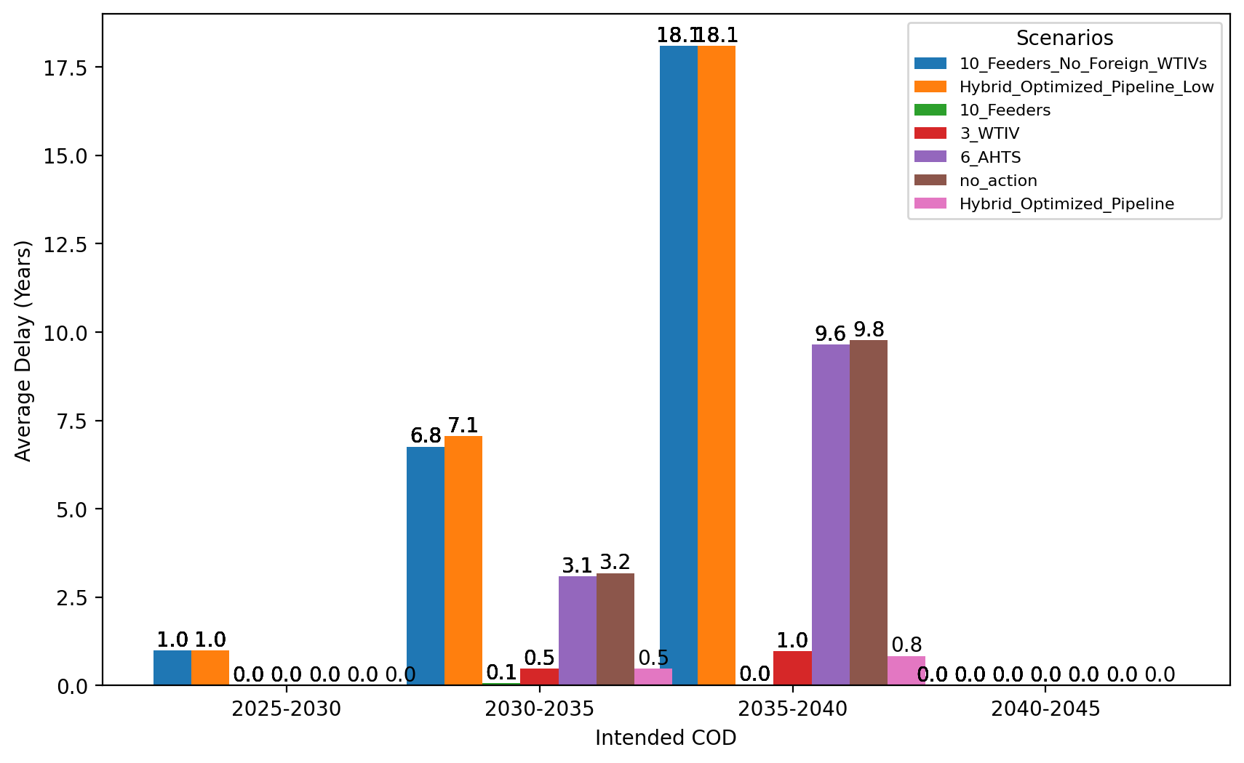
Average Delay Per Project by COD - NYNJ

Slide 27
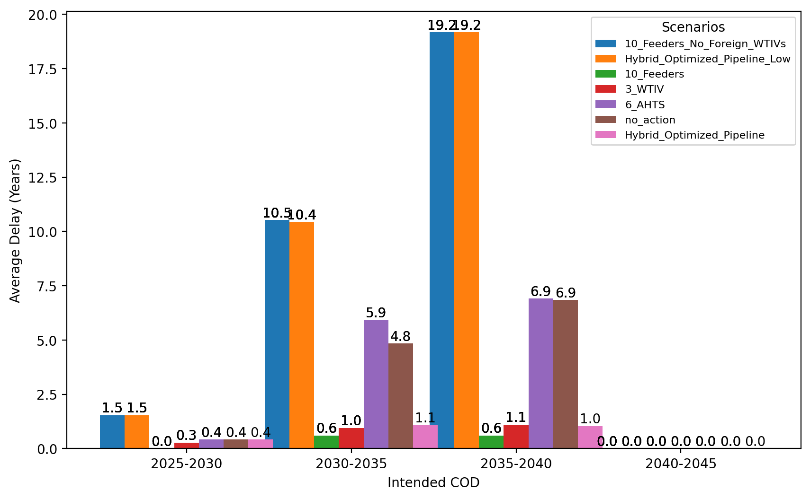
Average Delay Per Project by COD - Mid-Atlantic

Slide 28
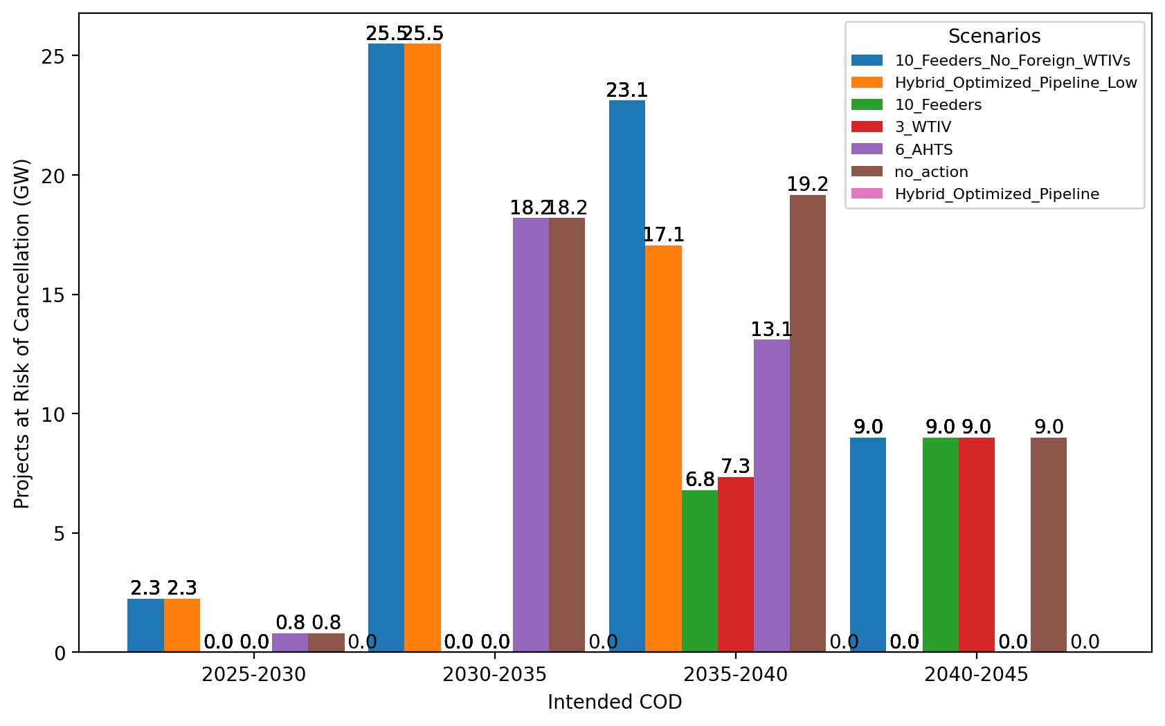
Total Capacity at Risk by COD - All Regions

Slide 29
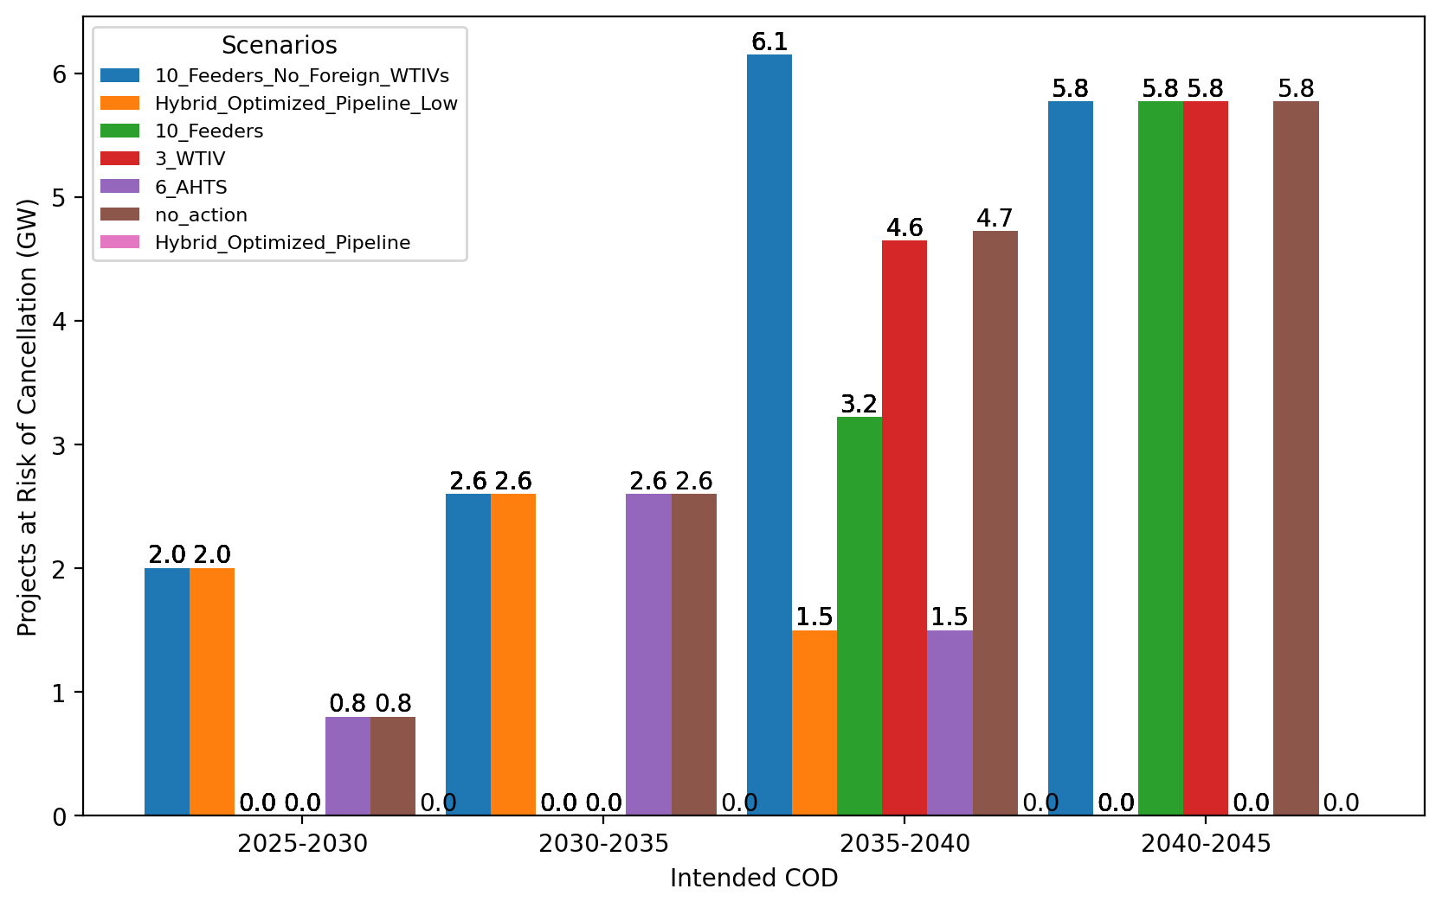
Total Capacity at Risk by COD - NE

Slide 30
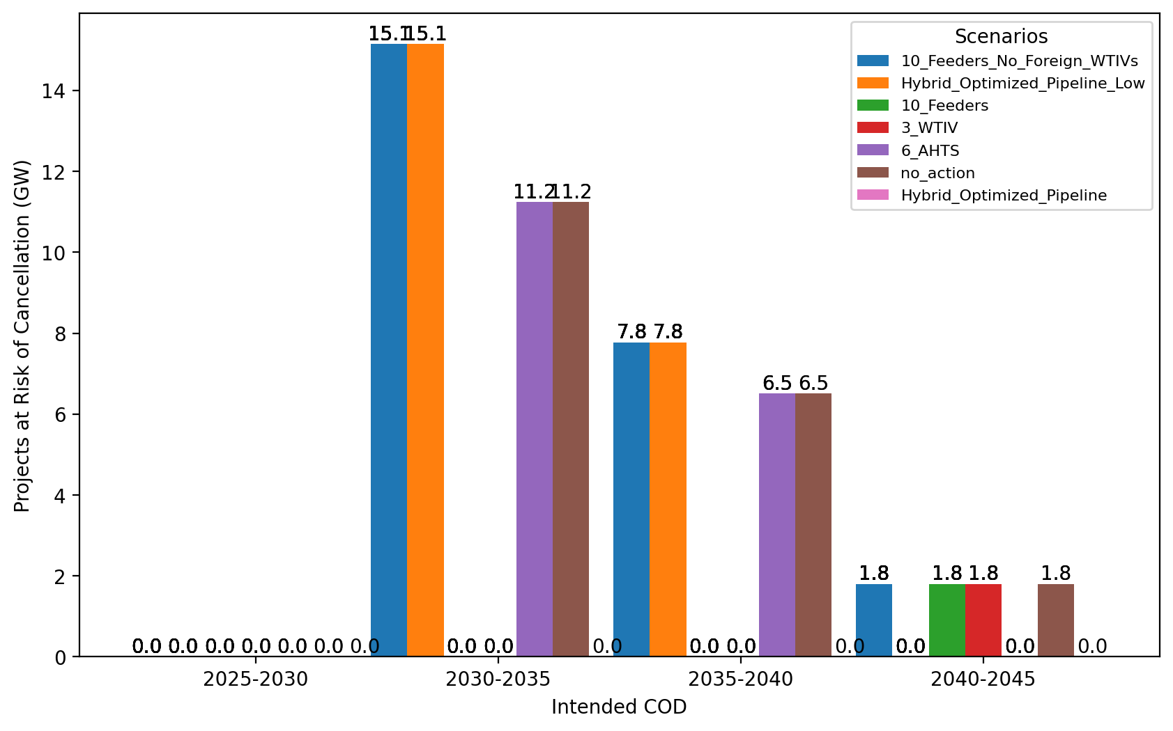
Total Capacity at Risk by COD - NYNJ

Slide 31
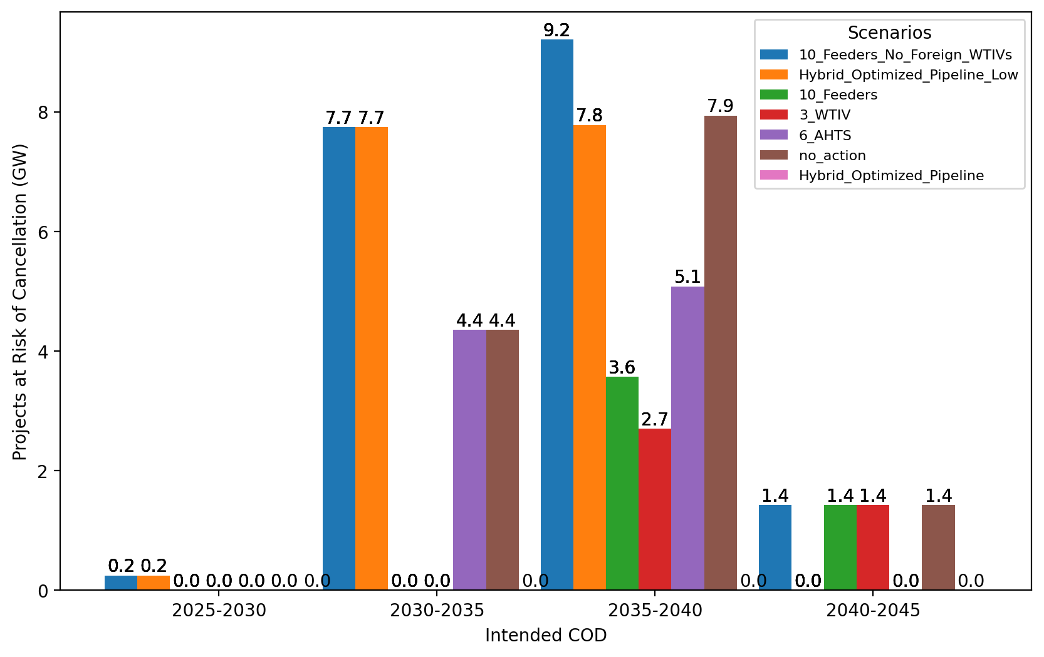
Total Capacity at Risk by COD - Mid-Atlantic

